Slide 1
Fabrication Variability
Inkeun Cho and James Edwards

Slide 2
Overview
What is fabrication variability?
Sources of variability
How to analyze & model variability
Ways to mitigate variability

Slide 3
What is Fabrication Variability?
Fabrication variability is variation in the physical characteristics of transistors, such as doping and patterning
It may be systematic or random
  Systematic = same every time
  Random = different each time
These variations cause electrical parameters of transistors (e.g., V_{T}) to deviate from their designed values
Random variability has become more prevalent with decreasing transistor sizes

Slide 4
Why is Fabrication Variability Significant?
When a digital circuit is designed, implementations for its gates are selected (e.g., using standard cell libraries)
The transistors used in the circuit are designed to have certain parameters (e.g. V_{T})
The performance of the circuit (power, timing) is determined based on those parameters
If the parameters vary from their expected value, then the circuit may not operate as intended or at all
  Some chips may function correctly but at a lower clock frequency or higher leakage power than intended
  Others may not function correctly at all and have to be discarded

Slide 5
Types of Variability
Spatial
  Device-to-device / intra-die
  Die-to-die (within a wafer)
  Wafer-to-wafer
Temporal
  Lot-to-lot (during production)
  Aging (during usage)
Our focus will be on device-to-device variability, as it is the most significant limitation at the process sizes used today (≤ 90 nm)

Slide 6
Systematic Variability
Systematic variability arises from limitations in fabrication equipment design and operation
    photolithography
    etching
    deposition and growth processes
    chemical-mechanical planarization (CMP)
    dosage of implants
    temperature of annealing steps
In theory, systematic variability can be modeled exactly and compensated for in the design phase
In practice, the variability is not known at design time or is too complex to model, so it is treated as random
Source: Pang, Liang-Teck and Nikolic, Borivoje. Measurements and Analysis of Process Variability in 90 nm CMOS. IEEE JOURNAL OF SOLID-STATE CIRCUITS, VOL. 44, NO. 5, MAY 2009.

Slide 7
Random Variability
Random variability is caused by atomistic effects (discreteness of atoms, quantum mechanical effects)
  Specific sources will be described next
Random variability causes device-to-device variations and cannot be predicted ahead of time
It can only be modeled statistically and requires adding a margin of error in the design phase
  Typically modeled as a normal (Gaussian) distribution
Notes:
Atomistic implies that the effect is more pronounced the closer devices get to atomic scale

Slide 8
Systematic vs. Random Variability
 | Systematic | Random
Source | fabrication equipment | atomistic
Scale | across chip, chip-to-chip, wafer-to-wafer | device-to-device
Local correlation | yes | no
Can be corrected | maybe | no
Can be modeled | yes | yes

Slide 9
Parameters That Vary
Threshold voltage (V_{T})
Saturation current (I_{on})
Device transconductance (G_{m})
Subthreshold (leakage) current (I_{off})
Oxide tunneling current / gate current (I_{g})

Slide 10
Sources of Variability
Random discrete doping (RDD)
Line-edge roughness & line-width roughness
Interface roughness & oxide thickness variation
Polysilicon granularity
High-k dielectric morphology

Slide 11
Random Discrete Doping (RDD)
Also known as random dopant fluctuation (RDF)
As transistors become smaller, the number of dopant atoms decreases as well
This effect is most pronounced in the transistor channel
  At 1 um: 5,000 atoms
  At 45 nm: 100 atoms
Source: Kelin Kuhn et al. Managing Process Variation in Intel’s 45nm CMOS Technology. Intel Technology Journal, Volume 12, Issue 2, 2008.

Slide 12

Random Discrete Doping (RDD)
RDD is a significant contributor to device-to-device V_{T} variation (σV_{T})
Responsible for ~65% of total σV_{T} at 65 nm and ~60% at 45 nm [Kuhn et al.]
Formula:
N
N
P
Large number of atoms: continuous distribution
Source: Peter A. Stolk et al. Modeling Statistical Dopant Fluctuations in MOS Transistors. IEEE TRANSACTIONS ON ELECTRON DEVICES, VOL. 45, NO. 9, SEPTEMBER 1998.
Small number of atoms: discrete distribution

Slide 13
Effects of RDD
As the number of dopant atoms decreases, the relative contribution of each dopant atom to V_{T} increases => higher variation in V_{T}
In addition, the location of the dopant atoms in the channel becomes important
  The edges of the source & drain regions are uncertain, causing variation in the capacitance and resistance of the source and drain
Source: Hon-Sum Philip Wong et al. Discrete random dopant distribution effects in nanometer-scale MOSFETs. Microelectronics Reliability 38 (1998).

Slide 14
Line-edge & Line-width roughness (LER & LWR)
LER = lines of device features are not straight
LWR = distance between lines is -not uniform
LER & LWR arise from the lithography and etching processes
They are most pronounced in poly-gate patterning
Effects
  Increased I_{off}
  Increased variation in V_{T}
LWR
LER
Source: Kuhn et al.

Slide 15

Line-edge & Line-width roughness (LER & LWR)
The limits of the lithography process are determined by the Rayleigh scaling equation
  W_{min} = minimum linewidth
  k₁ = dimensionless scaling parameter
  λ = exposure wavelength
  NA = numerical aperture of the projection optics
For current technology (F₂ laser, λ = 157.6 nm), W_{min} = 53 nm
Source: Brunner , Timothy A. Why optical lithography will live forever. Journal of Vacuum Science & Technology B: Microelectronics and Nanometer Structures, Vol. 21, Issue 6, Nov. 2003

Slide 16
Line-edge & Line-width roughness (LER & LWR)
As feature size approaches the minimum linewidth, statistical variation in incident photon count becomes significant
Other sources of variation are photoresist absorption rate, chemical reactivity, and molecular composition
Source: K. Bernstein et al. High-performance CMOS variability in the 65-nm regime and beyond. IBM J. RES. & DEV. VOL. 50 NO. 4/5 JULY/SEPTEMBER 2006.

Slide 17
Interface roughness & oxide thickness variation
The interface roughness due to oxide thickness variation leads to significant fluctuation in V_{th}[6]
  Introduced by Si/SiO2 interface roughness and polysilicon gate/SiO2 (remote) interface roughness through TOX (gate-oxide thickness) variation
  interface roughness can introduce more than 50% variation in the value of TOX for devices with a TOX of about 1 nm.

Slide 18
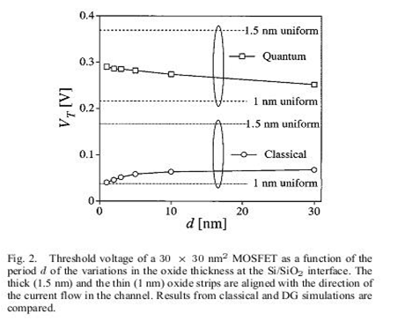

Interface roughness & oxide thickness variation

Slide 19
Interface roughness & oxide thickness variation
The unique random pattern of each MOSFET’s gate oxide and the related surface landscape and potential fluctuations will contribute substantially to the intrinsic parameter variation between such devices.
The intrinsic parametric variability due to Si/SiO2 and polysilicon-gate/SiO2 interface roughness is also statistically independent
The random Si/SiO2 and gate/SiO2 inter-faces are generated from a power spectrum corresponding to the autocorrelation function of the interface roughness

Slide 20
Interface roughness & oxide thickness variation
Sources
  Asenov, A.; Kaya, S.; Davies, J.H.; , "Intrinsic threshold voltage fluctuations in decanano MOSFETs due to local oxide thickness variations," Electron Devices, IEEE Transactions on , vol.49, no.1, pp.112-119, Jan 2002
  Asenov, A.; Cathignol, A.; Cheng, B.; McKenna, K.P.; Brown, A.R.; Shluger, A.L.; Chanemougame, D.; Rochereau, K.; Ghibaudo, G.; , "Origin of the Asymmetry in the Magnitude of the Statistical Variability of n- and p-Channel Poly-Si Gate Bulk MOSFETs," Electron Device Letters, IEEE , vol.29, no.8, pp.913-915, Aug. 2008

Slide 21
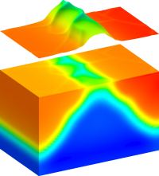
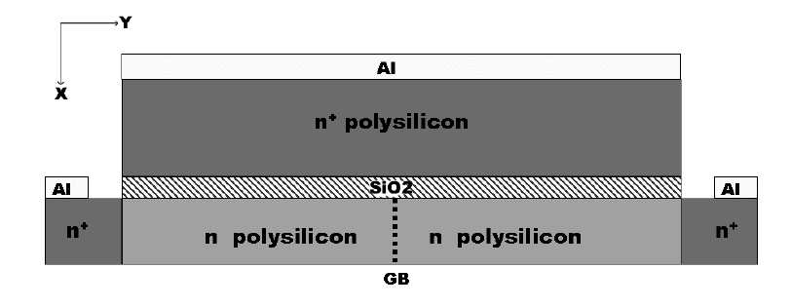
Polysilicon Granularity
Poly-silicon granularity (PSG) increases the uncertainty in gate doping and process variability
  Caused by Fermi-level pinning
  Gate dopant diffusion is enhanced along the grain boundaries(GBs)
  Leading to non-uniform poly-silicon gate doping
  Potential localized penetration of the dopants through the gate oxide in to the channel region.
Notes:
Left image source: http://www.goldstandardsimulations.com/services/statistical-variability/variability-sources/

Slide 22
Polysilicon Granularity
Polysilicon (polycrystalline silicon) is a form of silicon in which Si atoms do not form a single crystal but rather multiple crystals called grains.
The Fermi level of an atom is its highest electron energy level at absolute zero temperature
Normally, charge is redistributed at the interface between materials, and the Fermi level changes.
Due to the high density of defect states in poly-Si, the Fermi level is pinned, and electron diffusion is enhanced at the interface between grains
Source: Brown, A.R.; Roy, G.; Asenov, A. "Impact of Fermi level pinning at polysilicon gate grain boundaries on nano-MOSFET variability: A 3-D simulation study," Solid-State Device Research Conference, 2006. ESSDERC 2006. Proceeding of the 36th European, pp.451-454, 19-21 Sept. 2006
Source: http://hyperphysics.phy-astr.gsu.edu/hbase/solids/fermi.html#c1

Slide 23
Polysilicon Granularity
Effect of polysilicon granularity
  Parametric fluctuations
    V_{T} variability due to PSG is stronger than RDD in MOSFETs with L = 30 nm
  Fermi-level pinning was responsible for dramatically increasing the threshold voltage in PMOS transistors using a hafnium silicate (HfSiOx) film as a high-k gate dielectric, which decreased the driving ability of the transistor
Source: How a change in thinking led to the development of our low standby power CMOS technology and the story behind the birth of "ultra-thin high-k theory,"
http://www2.renesas.com/magazine/en/vol_0070/vol_0070_1.html

Slide 24
High-k dielectric morphology
To reduce the excess of gate leakage currents in MOS devices, the ultra thin SiO2 gate oxide is replaced by other high-k dielectric materials
Provides a thicker physical TOX to reduce the direct-tunneling gate leakage current while ensuring an ultra-thin electrical TOX
High-k gate dielectric and a metal gate process introduces significant process variability because of interface roughness between Si and the high-k dielectric.
Mobility degradation and TOX variation

Slide 25
Analyzing and Modeling Process Variability
The fabrication variability in the parameters in device cause severe variability in the performance of advanced VLSI circuits and systems.
The accurate modeling for the process variability
  Possible to predict the performance of VLSI circuits
  Robust design
  High yield rate

Slide 26
Models of Process Variability
Statistical models
  Worst-case corner
  Statistical corner
  TCAD-based statistical corner
  Monte Carlo
Analysis methods
  Statistical timing analysis
  Statistical leakage analysis

Slide 27
Worst-case Corner Model
Worst-case corner model gives designer the pessimistic process variability model by selecting the wide range of upper limit and lower limit
Main Idea
  Vth = Vtho + n*std(Vth)
  Offsetting the selected process-sensitive compact model parameters by fixed number n to account for the window of process variability
    Vtho is a selected model parameter of the typical model
    typical model is generated from the measured data on a single golden wafer of the center-line process
    n is selected to set the fixed lower and upper limits(typically 3 or 6)

Slide 28
Worst-case Corner Model
Worst-case four corner model
  Conventionally, process variability is modeled on the basis of the worst-case four corners
    corners for analog applications
      For modeling worst-case speed
        slow NMOS and slow PMOS(SS) corner
      For modeling worst-case power
        fast NMOS and fast PMOS(FF) corner
    corners for digital applications
      For modeling worst-case 1
        fast NMOS and slow PMOS(FS) corner
      For modeling worst-case 0
        slow NMOS and fast PMOS(SF) corner

Slide 29
Worst-case Corner Model
Advantages
  Worst case corner models give designers the capability to simulate the pass/fail results of a typical design and are usually pessimistic.
Disadvantages
  The fixed-corner method is too wide
  Some valid designs can not be accepted in worst-case corner model
  The correlations between the device parameters are ignored

Slide 30
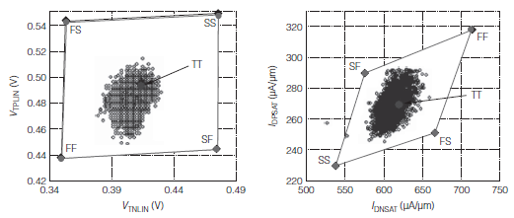
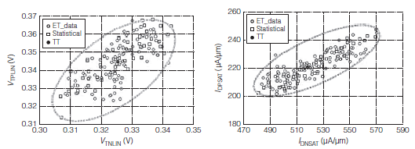
Worst-case Corner Model vs Statistical Corner Model
Data Range of NMOS Vth vs PMOS Vth
with Worst-case Corner Model
Data Range of NMOS Isat vs PMOS Isat
with Worst-case Corner Model
Source : Samar K. Saha, “Modeling Process Variability in Scaled CMOS Technology”, Design & Test of Computers, IEEE , vol.27, no.2, pp.8-16, March-April 2010
Data Range of NMOS Vth vs PMOS Vth
with Statistical Corner Model
Data Range of NMOS Isat vs PMOS Isat
with Statistical Corner Model

Slide 31
Statistical Corner Model
For more realistic modeling for process variability than worst-case corner model.
  Using data from different dies, wafers, and wafer lots collected over a long enough period of time to represents realistic process variability of the target technology
The difference between statistical corner model and worst-case corner-model
  Statistical corner model use the realistic std of the corresponding model parameter of its typical model
    Std is obtained from the distribution of a large set of production data
  Statistical models can pass a valid design, which were rejected in worst-corner model

Slide 32
TCAD-based Statistical Model
When developing a new VLSI technology, there is no historical production data to use as a basis for statistical modeling
The technology CAD (TCAD) modeling approach uses simulations to generate an initial statistical model
The simulations are chosen based on the lower and upper limits of the most sensitive process-control variables (e.g., gate-oxidation temperature, p- and n-halo implant dose and energy, TOX, and L)
The model is refined as data is collected from production runs
Source: Saha, S.K.; "Modeling Process Variability in Scaled CMOS Technology," Design & Test of Computers, IEEE, vol.27, no.2, pp.8-16, March-April 2010

Slide 33
Monte Carlo Model
A Monte Carlo simulation of a circuit is a series of simulation runs where the device parameters for each run are randomly generated based on the distribution of those parameters in the model
  In contrast, corner models use only lower and upper limits
Advantages
  Accurate
  Allows for directly estimating the yield of a VLSI design
Disadvantages
  Requires running many simulations
  Assumes that device parameters are independent
Source: Orshansky, M. et al. "A statistical performance simulation methodology for VLSI circuits," Design Automation Conference, 1998. Proceedings , pp. 402- 407, 15-19 Jun 1998

Slide 34
Statistical Timing Analysis
As process technologies have scaled, intra-die variations have grown to play a significant role in determining delay and power distributions
Random variables that captures intra-die variations can be independent or correlated across gates
  Monte Carlo based techniques even more expensive
  Corner based models cannot guarantee to cover the worst case enough.
Modeling the impact of fabrication randomness on the chip's timing characteristics.
  Predict the probability density function(PDF) of delay
  Predict the statistical spread in chip's timing randomness accurately.

Slide 35
Statistical Timing Analysis
Statistical Timing Analysis vs Deterministic Timing Analysis
P(A0)
Deterministic Timing Analysis
Ai
i
Ao
Arrival time Ao
= max(Ai + Dio , Aj + Djo)
Aj
0
j
Dio: Delay from Input Node i to Output node o
Djo: Delay from Input Node j to Output node o
P(A0)
Statistical Timing Analysis
A0
Arrival time Ao
=> CDF distributed

Slide 36
Statistical Timing Analysis
Block-based timing analysis
  Based on a topological traversal of the timing graph
  Generates the arrival times and required times for each node
  Working forward (and backward) from the clocked elements
  Advantage
    No path selection -> complete analysis
  Disadvantage
    Need to consider correlations for getting statistical max and min
Path-based timing analysis
  Extracting a set of paths from the circuit
  Sums gate and wire delays on specific paths
  Advantage
    The statistical analysis is simple
  Disadvantage
    Cannot cover the case that the unselected paths are relevant
    Path Selection is important

Slide 37
Statistical Leakage Power Analysis
Leakage Power becomes a major components of the total power
  Leakage power contributes approximately 50% of the total power dissipation in the 90nm technology(Intel)
Process variation has a significant impact on leakage
  The Ioff is closely related to Vth and Tox
Major components in leakage current
  Sub-threshold leakage(Isub) - closely related to Vth
  Gate leakage(Igate) - closely related to Tox

Slide 38


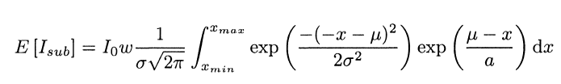

Statistical Leakage Power Analysis
High-level Statistical Analysis
  Useful in early design stage when detailed information about the design is not available
  Information : total device width or relative fraction of on/off devices in a design( without detailed gate level information)
The analysis process
  Assume that the process parameters(Vth) are normally distributed
J. Kao, S. Narendra, and A. Chandrakasan. Subthreshold leakage modeling and reduction techniques. In ICC AD '02: Proceedings of the 2002 IEEE/ACM international conference on Computer-aided design, pages 141-148, New York, NY, USA, 2002. ACM Press.

Slide 39
Statistical Leakage Power Analysis
Gate-level Statistical Analysis
  Estimation of leakage currents for individual gates and then summation of these estimates to calculate the overall leakage of a design

Slide 40
Mitigating Process Variability
Design-time optimization
  Statistical gate sizing
  Statistical buffer insertion
Post-silicon tunability
  Post-silicon tunable clock tree
  Ring oscillators
  Adaptive body bias & adaptive supply voltage

Slide 41
Statistical Gate Sizing
Problem in static gate sizing
  Based on the static delay model
    The static delay model cannot cover the actual delay later in a chip.
      Gate will have same delay all the time
    Uncertainty in wire delays
      Not all details of the final layout might be known yet
Statistical Gate Sizing
  Using statistical distribution of wire delay model and gate delay model
  Deciding the gate size under the desirable delay

Slide 42
Statistical Buffer Insertion
Buffer Insertion
  Widely used interconnection optimization method in intra-level cell
Statistical Delay Model
  Dk = Dko(Pio) + Dk(Xk, Yk, Pi)
    Pi : parameter variation
    k : Position
    Dko : Nominal value of Delay

Slide 43
Post-silicon tunable clock tree
Fabrication variability causes skew in a nominally balanced clock distribution network (tree)
To counter this, post-silicon tunable clock buffers can be inserted into the tree
  A tunable buffer consists of two inverters with a bank of capacitors in between
  Each capacitor has a pass gate that allows it to be connected to or disconnected from the output of the first inverter
  The delay of the buffer is set dynamically based on a clock phase detector to cancel clock skew
The goal is to obtain the best timing yield while inserting as few tunable clock buffers as possible
  Similar to the normal buffer insertion problem, but the cost of the buffer is proportional to its tunable range
Source: Jeng-Liang Tsai et al. "Statistical timing analysis driven post-silicon-tunable clock-tree synthesis," Computer-Aided Design, 2005. ICCAD-2005. IEEE/ACM International Conference on, pp. 575- 581, 6-10 Nov. 2005

Slide 44
Adaptive Body Bias (ABB)
ABB uses the transistor body effect to change V_{T} during circuit operation
  Normally, the body (substrate) of a MOSFET is tied to its source
  Using ABB, the substrate is forward or reverse biased within a range chosen to prevent crossing the forward threshold of the transistor junctions (CN03 used ±20% of nominal V_{DD})
ABB can be applied to all transistors or just to n-type or p-type transistors
Drawback: additional on-chip power networks are needed for the body voltage
Source: Chen, Tom and Naffziger, Samuel. Comparison of Adaptive Body Bias (ABB) and Adaptive Supply Voltage (ASV) for Improving Delay and Leakage Under the Presence of Process Variation. IEEE TRANSACTIONS ON VLSI SYSTEMS, VOL. 11, NO. 5, OCTOBER 2003.

Slide 45

Adaptive Supply Voltage (ASV)
ASV varies the supply voltage in order to trade speed for power consumption (CN03 used ±20% of nominal V_{DD})
Benefits
  No additional power distribution network needed
Drawbacks
  Potential reliability issues when exceeding the nominal supply voltage (due hot electron and electromigration)
  Memory may be less reliable when operated below its nominal supply voltage
Source: Chen, Tom and Naffziger, Samuel. Comparison of Adaptive Body Bias (ABB) and Adaptive Supply Voltage (ASV) for Improving Delay and Leakage Under the Presence of Process Variation. IEEE TRANSACTIONS ON VLSI SYSTEMS, VOL. 11, NO. 5, OCTOBER 2003.

Slide 46
Adaptive Body Bias (ABB) & Adaptive Supply Voltage (ASV)
Both approaches allow trading power for performance and vice versa
Both approaches are coarse-grained and thus are more suited to reducing variation between chips than they are to reducing within-chip variation
  The approach could be applied at a finer granularity, but power distribution would be more complex
Yields improved by up to a factor of 6, with a more pronounced difference for lower original yields
ASV provides a slightly better improvement in yield than ABB, but only by ≤2%
Source: Chen, Tom and Naffziger, Samuel. Comparison of Adaptive Body Bias (ABB) and Adaptive Supply Voltage (ASV) for Improving Delay and Leakage Under the Presence of Process Variation. IEEE TRANSACTIONS ON VLSI SYSTEMS, VOL. 11, NO. 5, OCTOBER 2003.

Slide 47
Ring Oscillators
A ring oscillator is a series of an odd number of inverters connected in a loop
The output of each inverter oscillates with a frequency that depends on the number of inverters and the electrical parameters of the inverters
If enough inverters are used, the frequency depends only on the average values of the parameters
Thus, the ring oscillator can be used as a reference circuit against which other circuits can be compared to measure the effects of various sources of variation
Source: Bhushan, Manjul et al. Ring Oscillators for CMOS Process Tuning and
Variability Control. IEEE TRANSACTIONS ON SEMICONDUCTOR MANUFACTURING, VOL. 19, NO. 1, FEBRUARY 2006.

Slide 48
Conclusion
Fabrication variability comes from many different sources and cannot be eliminated entirely
It negatively affects circuit performance and power dissipation
Good modeling of fabrication variability allows for estimating the effect of variability while designing a circuit
Circuits can and should be designed to be robust in the face of variability

